Slide 1
If you have not already done so, please download the QUartus Prime Lite at: https://www.intel.com/content/www/us/en/software-kit/849770/intel-quartus-prime-lite-edition-design-software-version-24-1-for-windows.html
Go to Learn course page to find this link

Slide 2
FPGA Intermidiate Workshop

Slide 3
Today’s Teaching Team
Orion Bruckman (EE)
15 years as a lab instructor, 10 years of R&D in computer and consumer electronics fields
Dr. Chris Rennick
Purveyor of all Engineering knowledge
Gabe Ghrayeb
IDEAs Clinic Co-op, 4A Nanotechnology Engineering

Slide 4


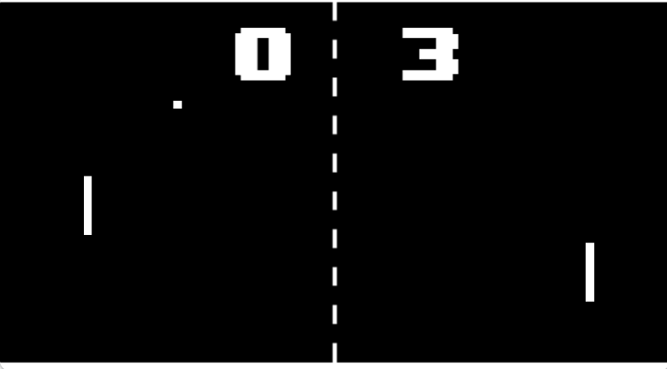
The Next LEvel
If you have already completed Day 1, we are now going to learn how to render visuals over HDMI
Using Logic to create video games
From: https://play.google.com/store/apps/details?id=net.bubik.pong&hl=en_AU

Slide 5
Learning objectives
Understand and use licensed IP cores in Quartus Prime.
Learn to write reusable logic and integrate multiple components.
Use conditional assignments effectively in VHDL.
Design and implement finite state machines (FSMs) in a hardware context.

Slide 6
Questions?

